Slide 1
Bank Customer Churn Predictions
By Siddharth Solanki
4th year CE Div-2
Notes:
Respected teachers and Committee members, today I am thrilled to take you through an intriguing voyage into the world of data science and its impactful applications in the banking sector. Our story revolves around a critical concern faced by banks worldwide – customer churn.

Slide 2
Churn Modelling
Predict if a bank’s customer will stay or leave the bank
Business case:
banking
Objective
Notes:
Picture this: a bank's customer, like the ebb and flow of tides, can choose to stay or leave, potentially affecting the bank's stability and growth. Join me as we unravel the tale of how we harnessed the power of data to predict whether a customer would stay or exit, thus empowering banks to make informed decisions.
The Problem: Imagine standing at a crossroads, facing a challenging question: How can we anticipate if a bank's customer is on the verge of leaving? This question ignited the spark of curiosity within us, driving us to embark on a mission to find a solution. We understood that unraveling this enigma required not just intuition, but the analytical prowess of data science.

Slide 3
Churn Modelling
Kaggle Churn Modelling Dataset
10,000 records
Demographic information
Banking information
Data Source
Notes:
With our goal set, we dived headfirst into the sea of data. Armed with a source of 10,000 bank records, we meticulously engineered a solution.

Slide 4
Churn Modelling
ETL & EDA
Create and save Machine Learning models
Deployment of ML models
How ?

Slide 5
ETL & Exploratory Data Analysis

Slide 6
ETL
Kaggle Dataset → very clean
Removing features not needed for ML and using :
RowNumber
CustomerId
Surname
Save it as the analytical base table (abt)
abt → input to all modelling notebooks
Extract, Transform, Load
Notes:
Our journey commenced by cleaning the data, ensuring that our sails were set right for the voyage ahead. Using the power of pandas, we sailed through the dataset, removing superfluous details.

Slide 7
Feature Selection
Credit Score
Geography
Gender
Age
Length of Customer Tenure
Balance
Number of Bank Products Used
Credit Card Usage
Membership Activity
Estimated Salary
Exit Status.
Notes:
We finally arrived at a comprehensive list of attributes that would serve as our compass: Credit Score, Geography, Gender, Age, Length of Customer Tenure, Balance, Number of Bank Products Used, Credit Card Usage, Membership Activity, Estimated Salary, and Exit Status.

Slide 8
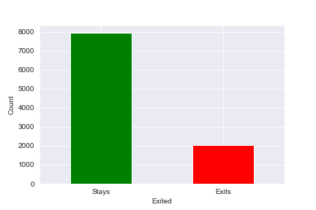
Target Feature Distribution
Imbalanced dataset:
Stays - 79.63%
Exits - 20.37%
Handling imbalanced classes:
SMOTE*
*Synthetic Minority Over-sampling Technique
Notes:
A critical revelation emerged: our dataset was a landscape of imbalance. The "Stays" held a commanding majority of around 80%, whereas the "Exits" constituted a mere 20%. This disparity could have hindered our progress, but we deftly maneuvered using the Synthetic Minority Over-sampling Technique (SMOTE), a tool that synthesized new data points to balance the scales. Through this method, we ensured that our predictive models would not be biased, enabling us to forge ahead.

Slide 9
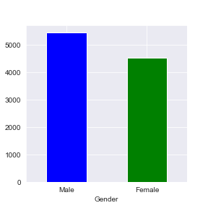
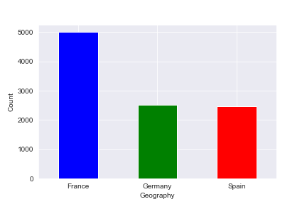
Distributions of Categorical Features
More males than females
France 50%; Spain, Germany 25% each

Slide 10
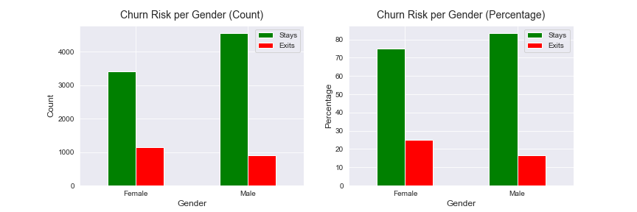
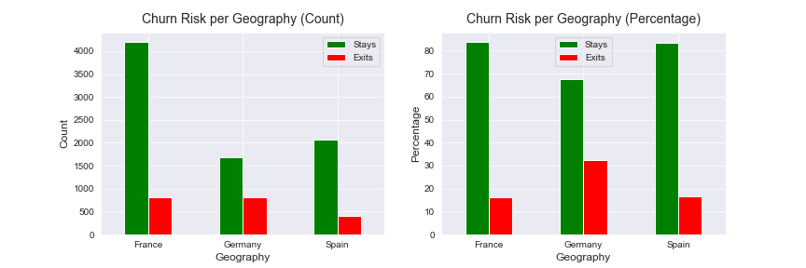
Churn Segmentation by Gender/Geography
Leaving bank:
females 25%
males 16%
1 of 3 German customers
Germany: least customers → most churn
Notes:
As our ship sailed further into the data sea, intriguing patterns materialized. A gender divide emerged—female customers were more prone to leaving the bank at a rate of 25%, compared to 16% among males.
Our voyage also led us to the lands of geography. Germans, though a minority, stood out as the most likely to bid adieu to the bank, with nearly a third of them exiting.

Slide 11
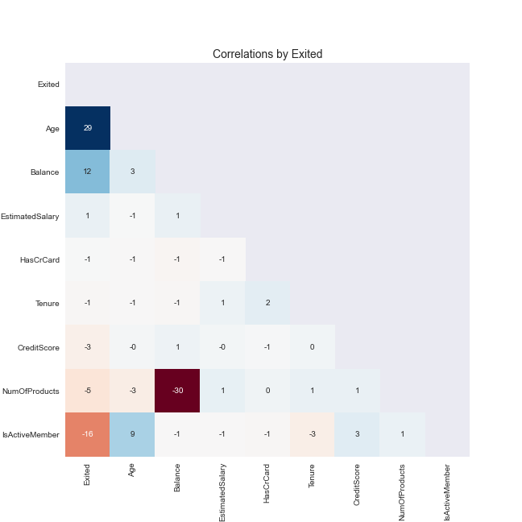
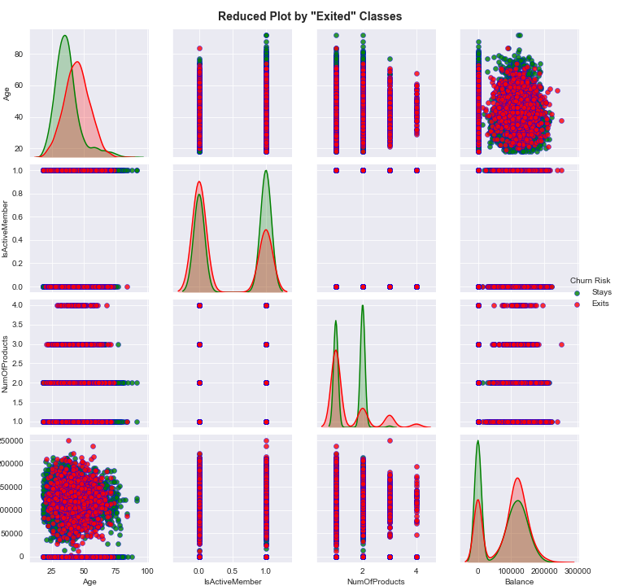
Correlations and Pairplot
Notes:
Very weak correlations in general. Only weak positive correlation with age, very weak positive correlation with balance, and very weak negative correlations with number of products and membership.
The density plots on the diagonal make it easier to compare these distributions. We can notice that only few features have slightly different distributions. For example, from the density plot for Age, it could be seen that older people have slightly higher tendency to leave the bank.

Slide 12
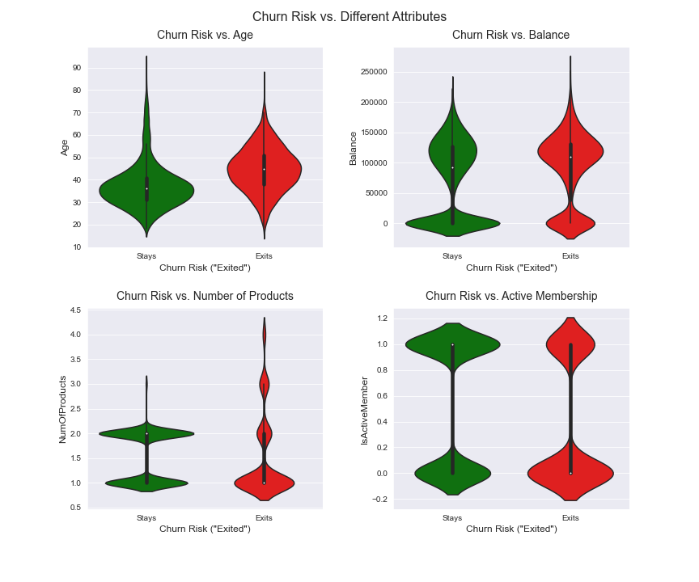
Violin Plots
confirming insights from correlations and pairplot - most likely to leave:
older customers
customers with more products

Slide 13
Machine Learning Modelling

Slide 14
Used Models
Scikit-learn
Decision Tree
K-nearest Neighbor
Logistic Regression
Random Forest
Support Vector machine (SVM)
Notes:
Eager to predict customer behavior, we embarked on a rigorous exploration of seven machine learning models: Logistic Regression, Decision Tree, Random Forest, K-Nearest Neighbor, Support Vector Machine.

Slide 15
Model Training Steps
load abt
features - target variable split
train - test split
preprocessing pipeline
model pipeline
hyperparameters tuning:
parameters grid
GridSearchCV
save best fit model

Slide 16
Pipelines
preprocessing pipeline
preprocess = make_column_transformer(
(MinMaxScaler(),num_features,
(OneHotEncoder(sparse=False), cat_features))
model pipeline
model = imbl_pipe(
preprocess, SMOTE(sampling_strategy='auto', random_state=random_state),
“model_classifier”*)
*replace with a classifier for the used model

Slide 17
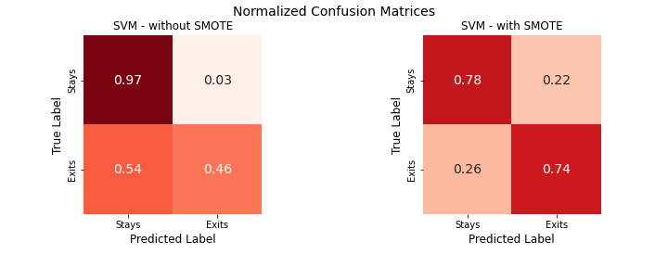
Why SMOTE?
(Synthetic Minority Over-sampling Technique)
better recall results (a goal for customer churning tasks)
TP: 46% → 74%
pretty close TP and TN
Notes:
Here, the spotlight shines on SMOTE once more. It stood as our ally, eradicating the bias caused by imbalanced data, and particularly aiding the Support Vector Machine model.

Slide 18
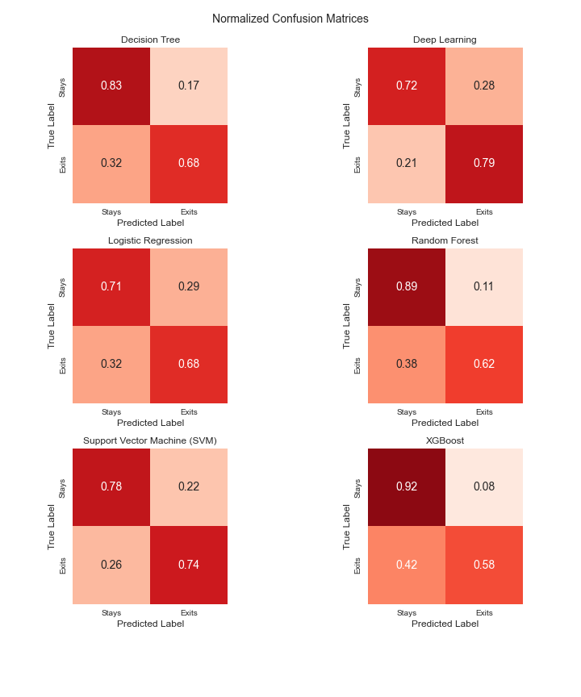
Summary
evaluation:
recall, f1-score
Goal achieved:
increased TP, decreased FN
Best models:
SVM

Slide 19
Deployment of ML Models

Slide 20
Flask and HTML - 1
app.py - Flask API
loads models
receives customer details through GUI
computes and returns predictions
returns customer info table
HTML/CSS/Bootstrap
HTML template and CSS styling to enter customer info
jinja - loads data passed by Flask:
predictions
customer info table

Slide 21
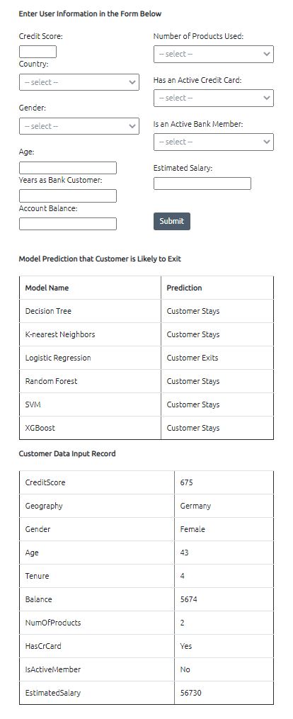
Flask and HTML - 2
app.py
.
.
.
@app.route('/predict', methods=['POST'])
def predict():
.
.
.
return render_template('index.html', maind=maind)
.
.
customer info
predictions
customer table
Notes:
As we neared our destination, the pieces of our puzzle began to form a coherent picture. Through the fusion of Flask, HTML, and CSS, we sculpted an interactive app. This app seamlessly integrated with our data and models, allowing users to input information and receive predictions regarding a customer's likelihood to exit the bank. A novel way to navigate an age-old problem.

Slide 22
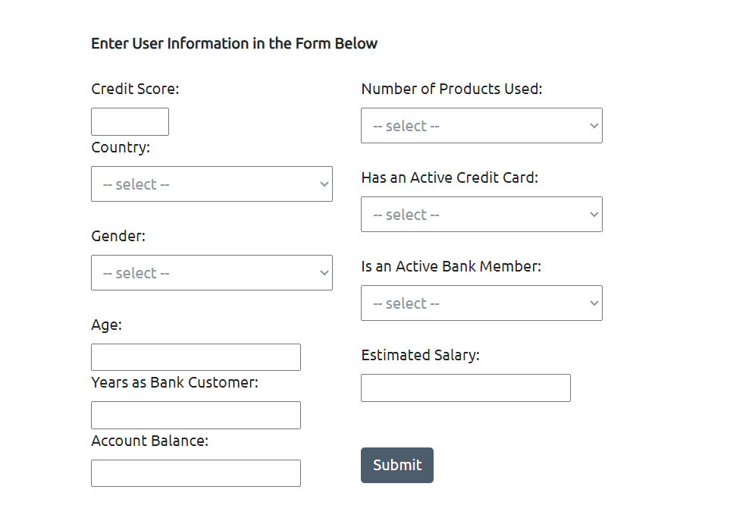

Slide 23
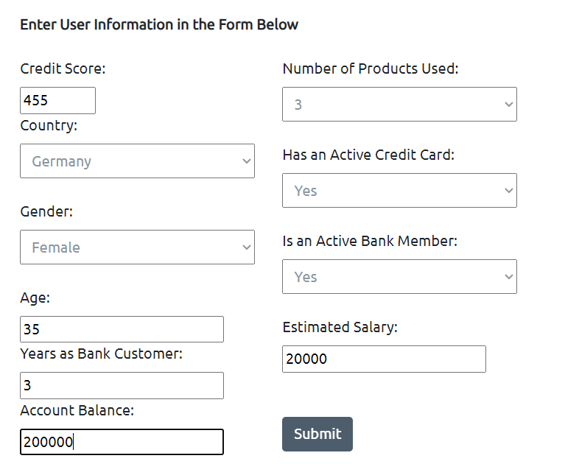

Slide 24
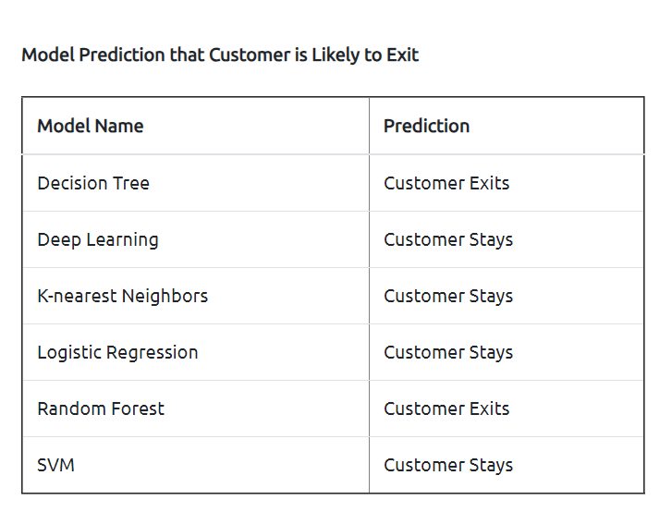

Slide 25
Conclusions
best models:
SVM
huge difference with SMOTE
ways for improvement
more data points
Deep Learning
feature selection
feature engineering
additional ML algorithms and imbalance handling techniques
finer hyperparameter tuning
Notes:
Respected teachers and committee members, our voyage through the intricacies of bank churn prediction has brought us to a pivotal moment. Armed with data and the tools of machine learning, we stand on the cusp of a new era in banking, one where customer retention is not merely a guessing game but a calculated endeavor. Our tale beckons you to embrace the power of data science, to explore the depths of customer behavior, and to set forth on your own journey of discovery and transformation.
So, I invite you all to embark on your quest – whether you're a banker seeking stability, an entrepreneur aiming for growth, or a curious mind fascinated by the realms of data. Together, let's sail towards a future where data illuminates the path to better decisions and a stronger banking landscape.

Slide 26
Questions?

